Slide 1
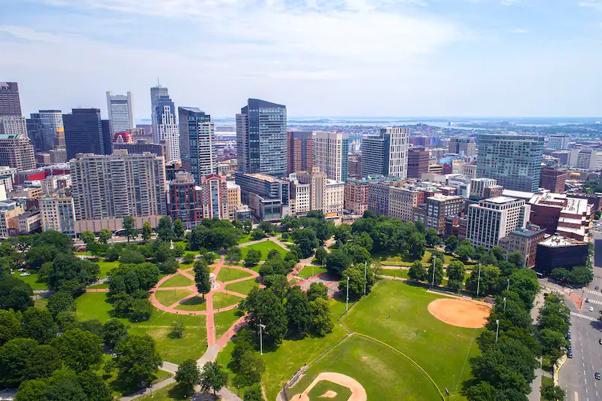
Gun Violence - Team 3
Gun Violence
Team Members:
Sarah Bonna (Team Lead),
Brian Mahabir,
Shivangi,
Showndarya Madhavan

Slide 2
Project Motivation
Gun Violence
Recent uptick in gun possession among youth in Boston's District 4
Need to understand the drivers of gun violence in the district and the city as a whole.
Inform policies that can improve the district and reduce the incidence of gun violence.

Slide 3
Project Goal
Gun Violence
To understand the drivers of gun violence in Boston's District 4 and the city as a whole, with a focus on identifying the variables associated with increases or decreases in gun violence.

Slide 4
Project Background
Gun Violence
To understand the project, it would be helpful to have knowledge of the factors that contribute to gun violence, such as poverty, access to firearms, mental health, and social dynamics.
Familiarity with the existing programs designed to address gun violence, their effectiveness, and their limitations would also be useful.

Slide 5
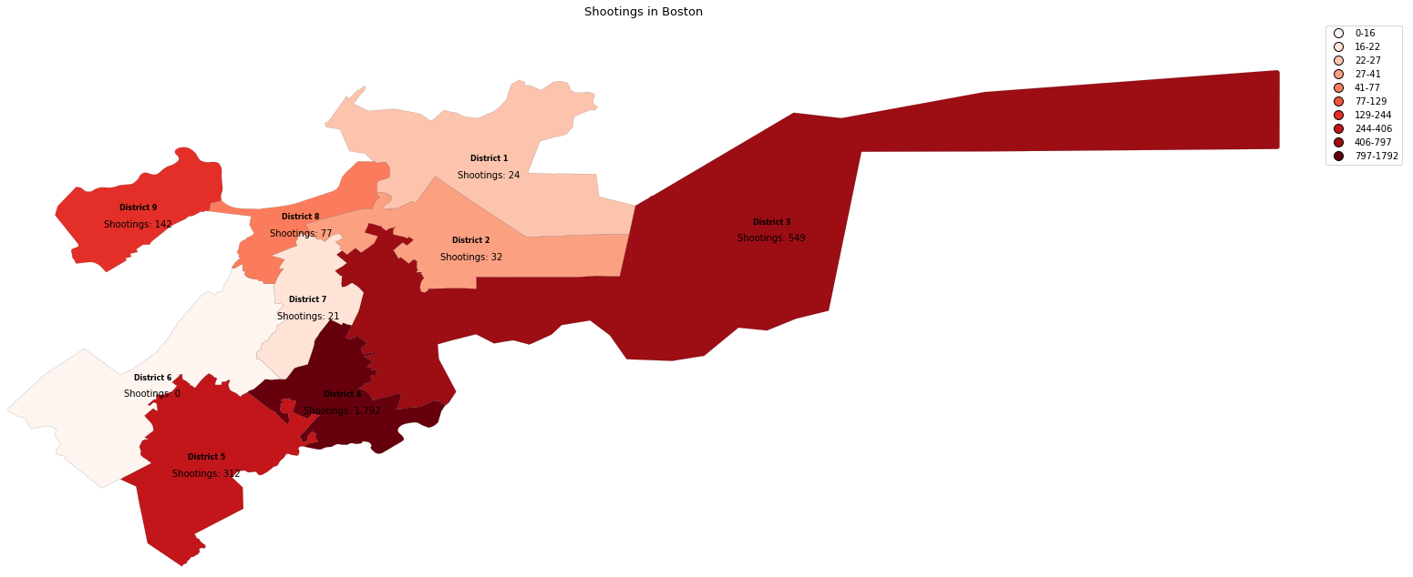
District wise intensity of gun violence w.r.t incidents count
This plot demonstrates the stark difference in the intensity of gun violence incidents in District 4, which is more than twice, compared to the second most affected district

Slide 6
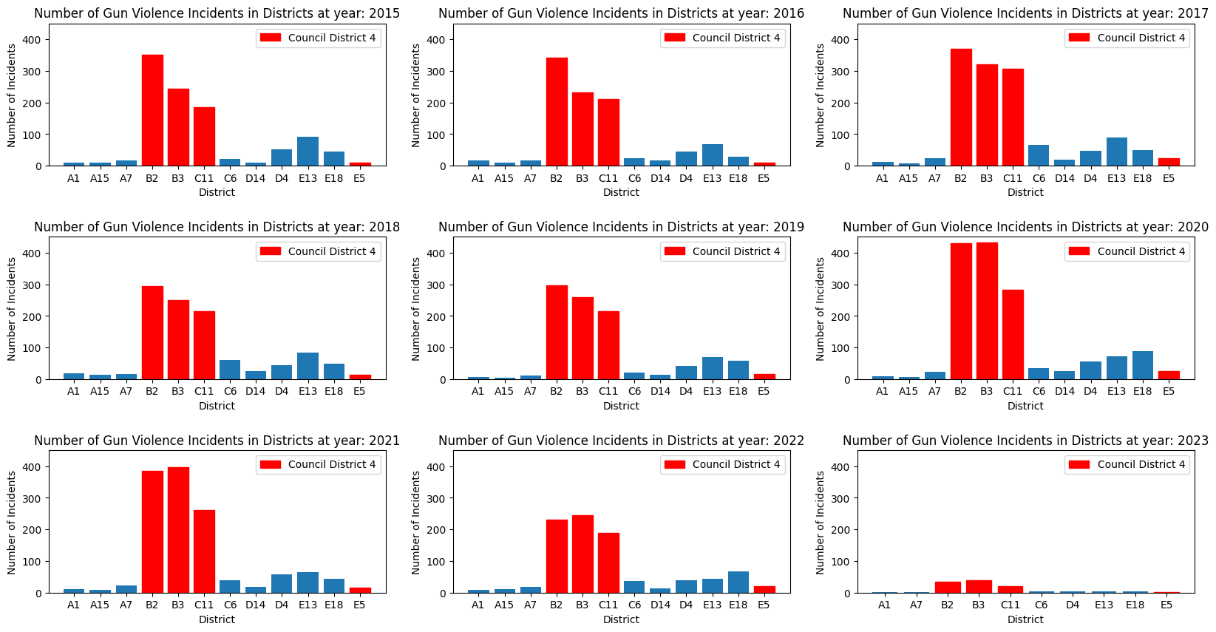
Rate of Gun Violence Incidents for Districts per Year
For every year the trend of gun violence for each police district is fairly unchanging. This showcases that gun violence is not inherently dependent on the timeframe

Slide 7
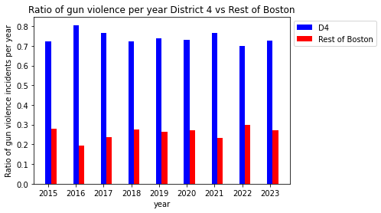
Ratio of Gun Violence in D4 vs Rest of Boston per year
Key Findings:
District 4 has the highest ratio of gun violence every single year from 2015 to 2023, slightly more than twice to rest of Boston
Highest ratio of gun violence in 2016 - 80% of gun violence in District 4
In 2023 - 70% of gun violence so far in District 4.

Slide 8
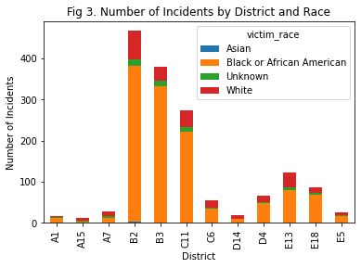
Number of Incidents by District and Race (All Districts)
Key Findings:
Black residents are disproportionately affected by shooting incidents.
Unknown ethnicity victims are present in relatively high numbers - need improved reporting and data collection methods.
Incidents involving Asian victims are almost negligible.

Slide 9
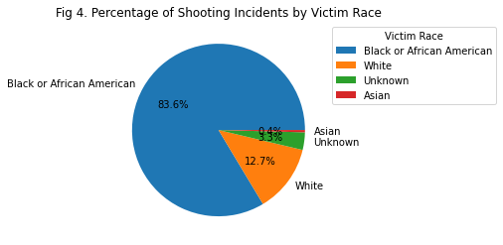
Percentage of Shooting Incidents by Victim Race in D4
Key Findings:
Black residents in the D4 district are disproportionately affected by shooting incidents.
Further analysis and investigation needed to understand the underlying reasons for this disparity to develop effective strategies for reducing gun violence in the area.

Slide 10
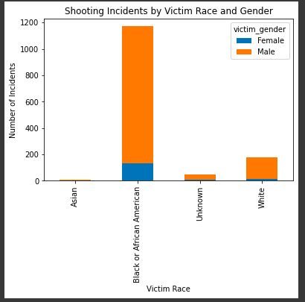
Shooting Incidents by Victim's Race and Gender
Key Findings:
Black Men are targeted the most.
Victim count of White Men are low compared to Black Men.

Slide 11
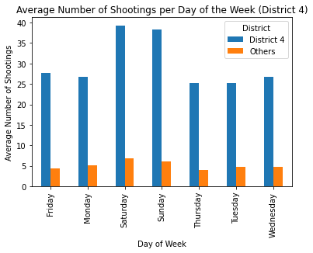
Average number of shootings per day of the week vs district (across the years)
Key Findings:
Avg # of shootings in District 4 is remarkably higher than all other districts combined
Higher avg # of shootings over the weekend (Saturday, Sundays)

Slide 12
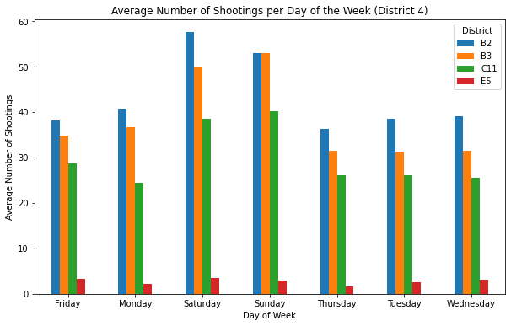
Average number of shootings per day of the week vs district (across the years)
Key Findings:
Out of the 4 police districts constituting District 4, the avg # of shootings in District B2 is the highest
Higher avg # of shootings over the weekend (Saturday, Sundays)

Slide 13
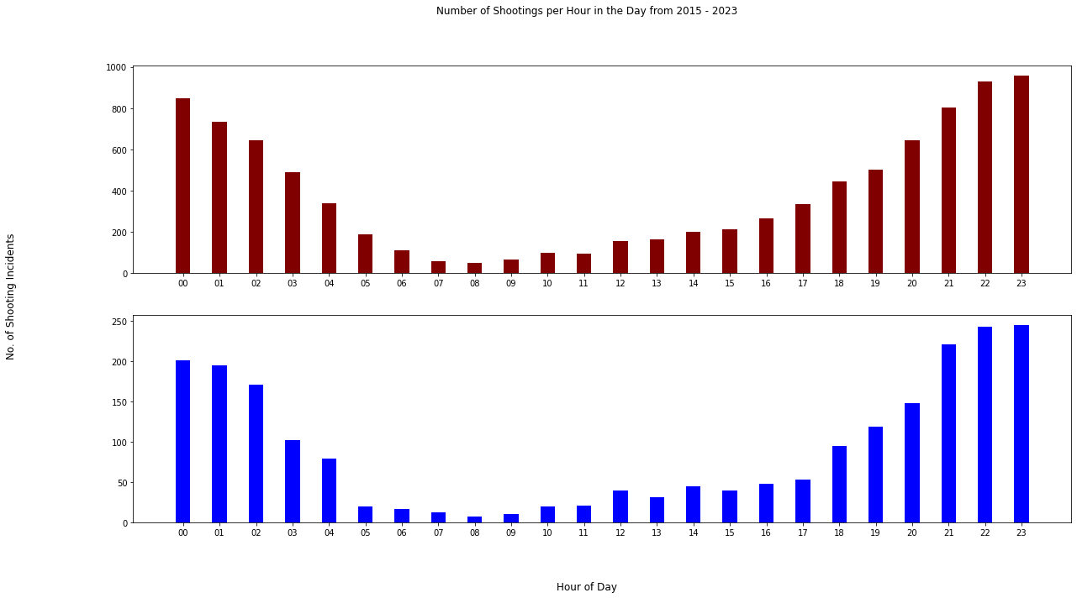
Shooting incidents Segmented by Hours
More gun incidents happen at night rather than during the day, parabolic trend of gun violence incidents, gun violence incidents in council district 4 have the same trend as the rest of Boston, indicating nothing abnormal about gun violence incident times in District 4.
Notes:
Key Findings from this graph:
District 4 has the highest ratio of gun violence every single year from 2015 to 2023.
The disparity in the ratio of gun violence between District 4 and the rest of Boston ranges from slightly more than twice to slightly more than 4 times.
The highest ratio of gun violence occurred in 2016, with 80% of gun violence in that year occurring in District 4.
In 2023 alone, 70% of gun violence thus far occurred in District 4.

Slide 14
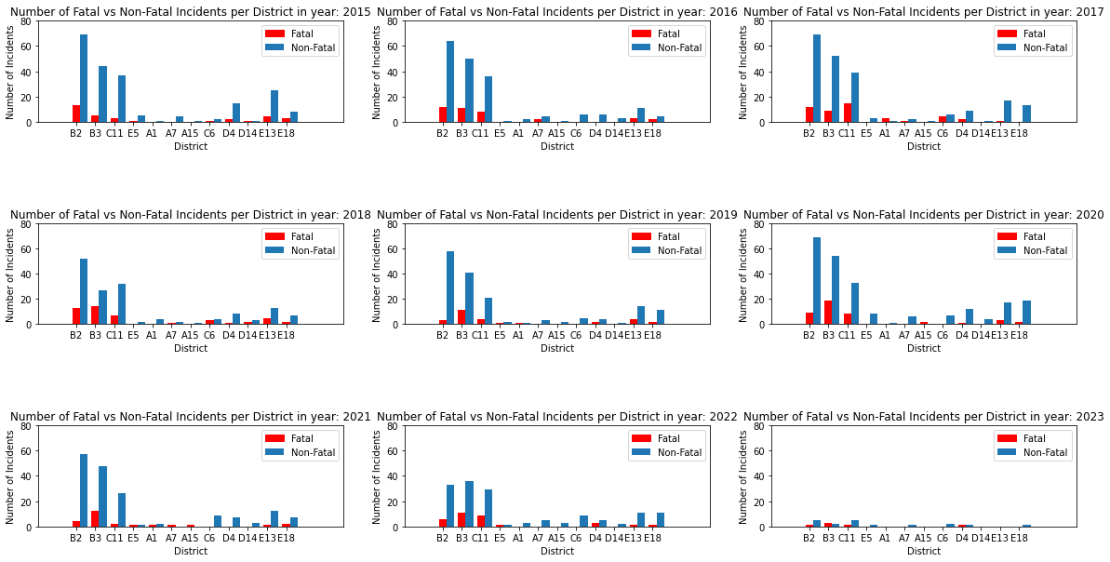
Number of Fatal vs Non-Fatal Incidents per District per Year
2023: other districts have more non-fatal shooting incidents than fatal ones (except B3). Some districts (A15 in 2016, 2019, etc.): no fatal shootings and even negligible non-fatal shootings. B2: highest number of non-fatal shooting incidents yearly, except in 2022 (B3 had the highest number). B3: highest number of fatal shooting incidents every year from 2018 to 2023.

Slide 15
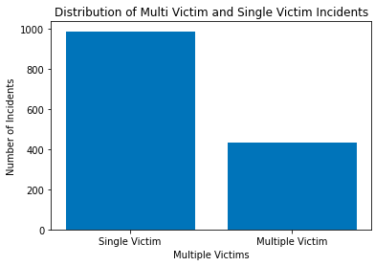
Multiple Victims vs Single Victims
Key Findings:
The number of single victims is almost double that of multiple victims
Targeted attacks outnumber mass shootings / family related attacks
Notes:
Bri

Slide 16
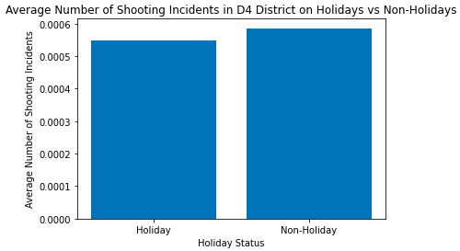
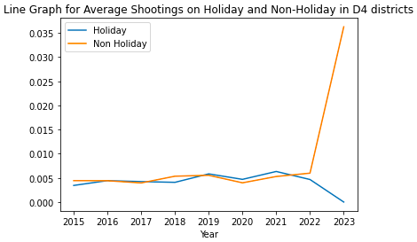
Average Number of Shooting Incidents on Holidays vs Non-Holidays
Key Findings:
We can see that number of incidents on Holidays and Non-Holidays are almost similar.
Notes:
Bri spike isn't accurate because we don't have enough data yet.

Slide 17
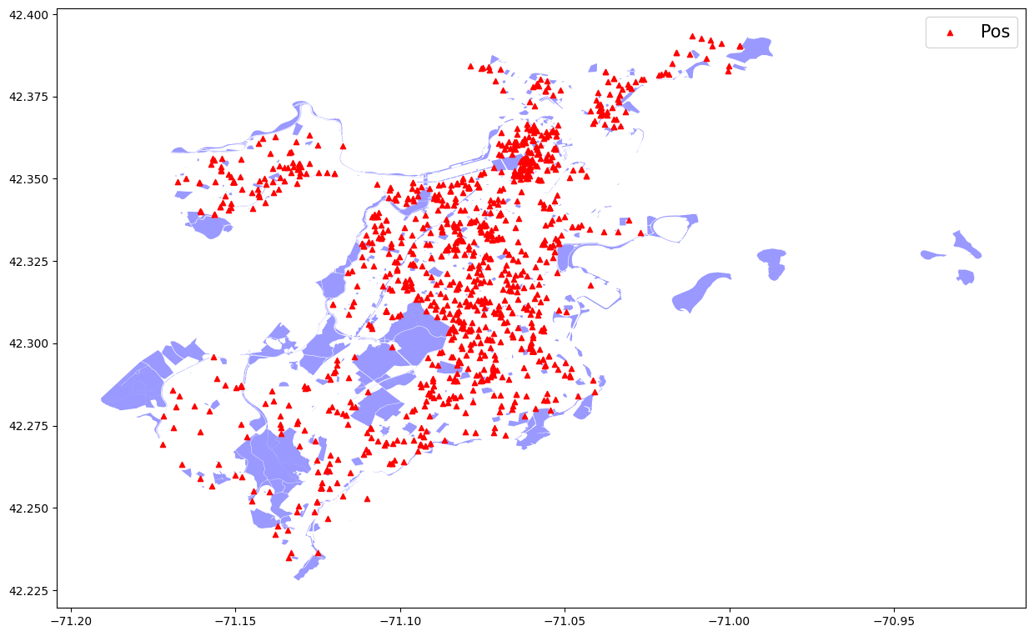
Parks Gun Violence Map
Key Findings:
Most gun violence does not happen in parks
Boston has a high park area ratio to city its hard to say if shootings happen near parks with this bias

Slide 18
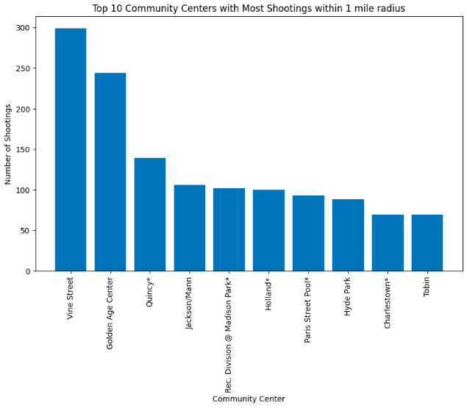
Top 10 Community Centers with Most Shootings
Key Findings:
More shootings near Community Centers seem to happen in City Council 1, with 3 Community Centers each in the top 10 list.
There is only 1 Community Center from City Council 4 (Holland) in the top 10 list.
There is only one Community Center from City Councils 2, 4, 5, 8 and 9 in the top 10 list.

Slide 19
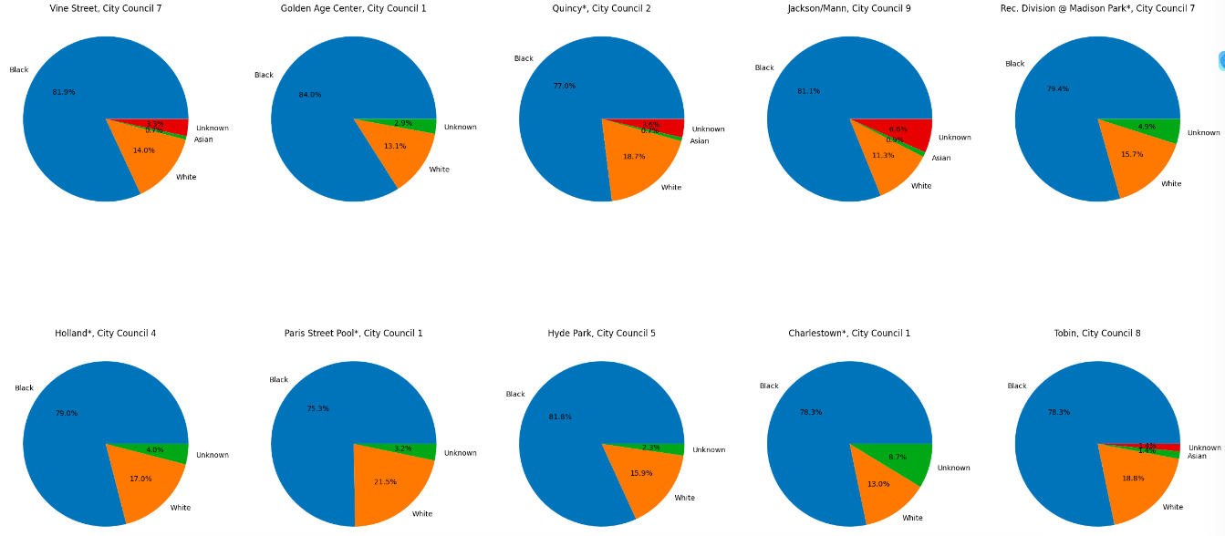
Race Segmentation for Community Centers
Key Findings:
More than 75% of the victims are Black.
The Community Center at Paris Street Pool has the highest number of White victims
The Community Center at Jackson/Mann has the highest number of victims of unknown race with 6.6%.

Slide 20
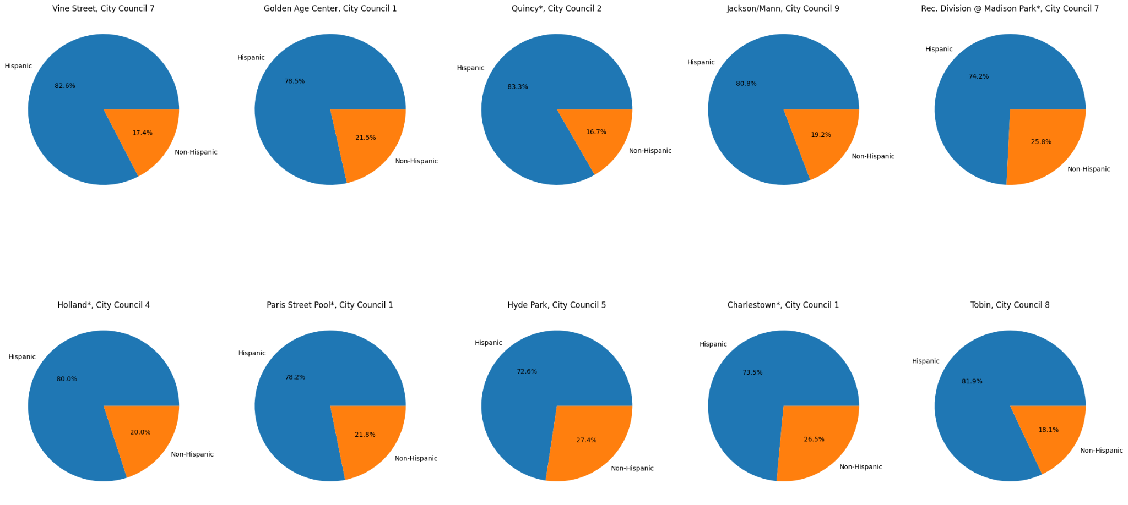
Hispanic Segmentation for Community Centers
Key Findings:
In the top 10 community centers most affected by gun violence the majority of people identify as Hispanic

Slide 21
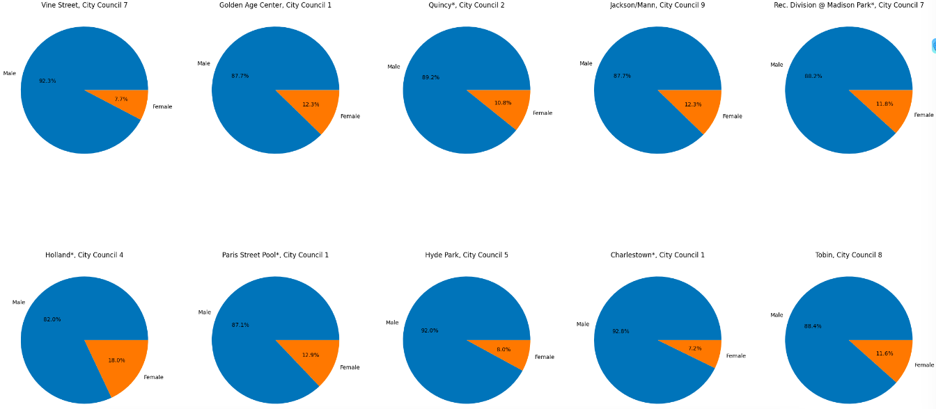
Gender Segmentation for Community Centers
Key Findings:
There are always more male victims than female victims (more than 80% of the victims are males in every case vs more than 7% for females).
Charlestown in City Council 1 has the highest percentage of male victims at 92.8%
Holland in City Council 4 has the highest percentage of female incidents with 18%

Slide 22
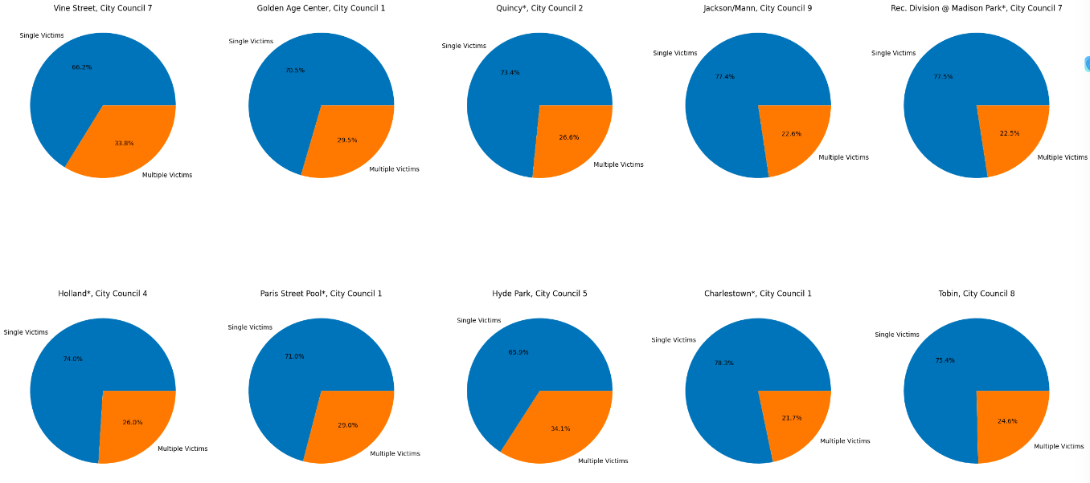
Single Victim vs Multiple Victims for Community Centers
Key Findings:
There are always more incidents with single victims than multiple victims (more than 60% of the incidents have a single victim in every case vs more than 21% for multiple victims).
Charlestown in City Council 1 has the highest percentage of incidents with a single victim at 78.3%, whereas for multiple victims, it is at Vine Street in City Council 7, with 33.8%.

Slide 23
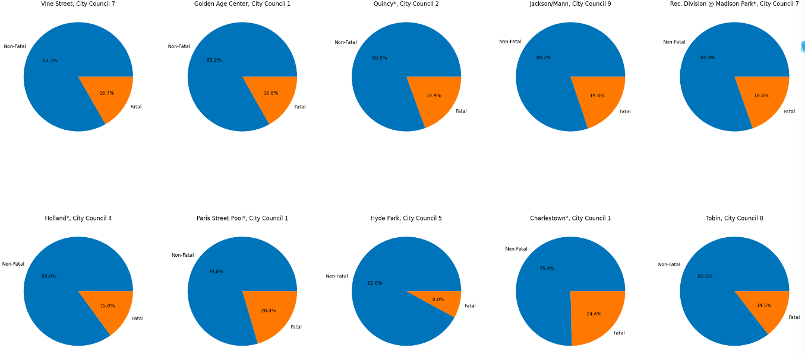
Fatal vs Nonfatal Shootings for Community Centers
Key Findings:
In all the Community Centers in the top 10 list, there are always more non-fatal than fatal incidents (more than 75% of the incidents are non-fatal in every case vs more than 14% for fatal ones).
Hyde Park in City Council 5 has the highest percentage of non-fatal at 92%, whereas for fatal ones, it is at Charlestown in City Council 1, with 24.6%.

Slide 24
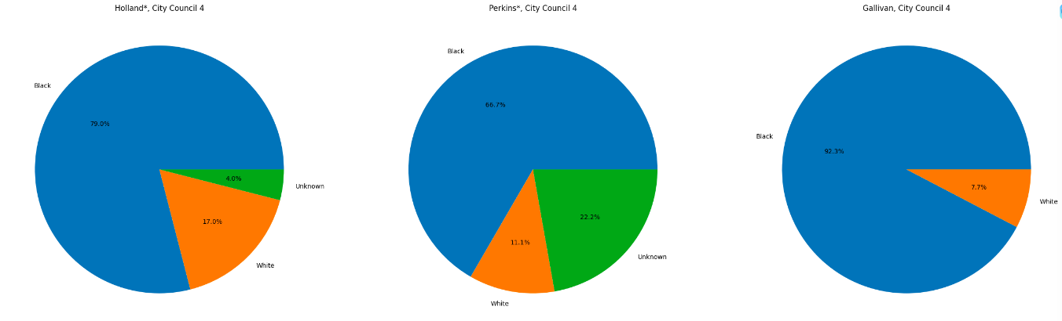
Race Segmentation for D4 Community Centers
Key Findings
For the top 3 community centers in D4 We see that the majority race that is affected are black
White and the rest of unknown races combined at most have 1/3 the amount of gun violence incidents while the rest is black
These community centers are located in predominantly black neighborhoods so our graphs represent those biases

Slide 25
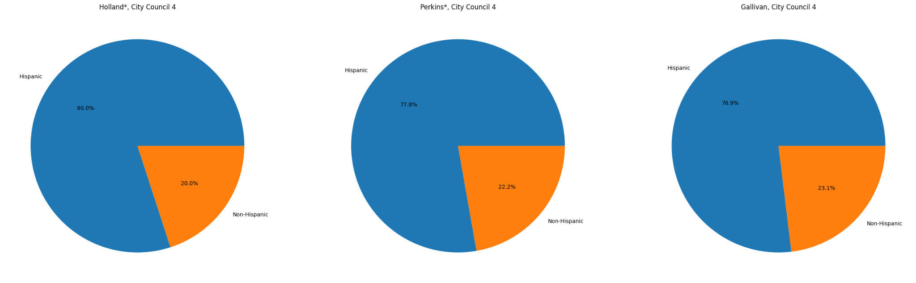
Hispanic Segmentation for D4 Community Centers
Key Findings:
D4 has the same trend as the rest of Boston
More people who are affected by gun violence identify as hispanic

Slide 26
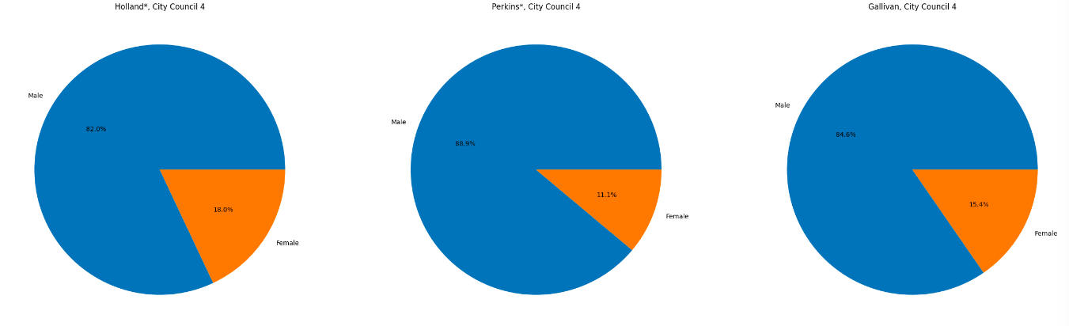
Gender Segmentation for D4 Community Centers
Key Findings
For the top 3 community centers in D4, we see that male victims outnumber female victims by 4 to 1.
Generally, it's considered that men perpetrate more gun violence than women (due to sociological properties) so seeing men victims also high is interesting

Slide 27
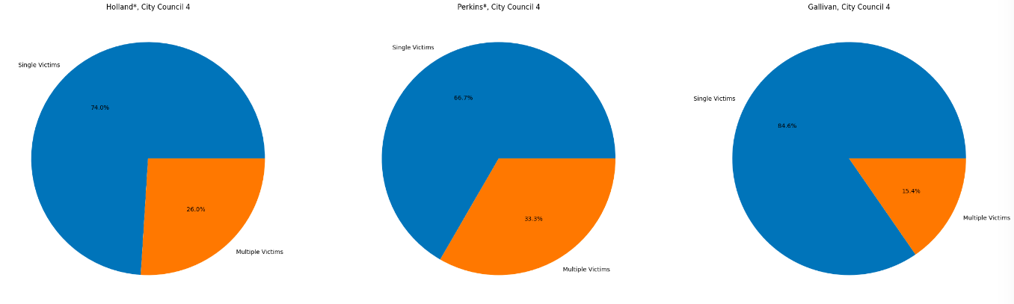
Single vs Multiple Victims for D4 Community Centers
Key Findings
For the top 3 community centers in D4 Single Victims outnumber Multiple Victims almost 4 to 1
Community centers are a public place with lots of people so it is interesting that multiple victims are less than single. This could highlight a bias in our data where we get a range of incidents near the community center within one mile

Slide 28
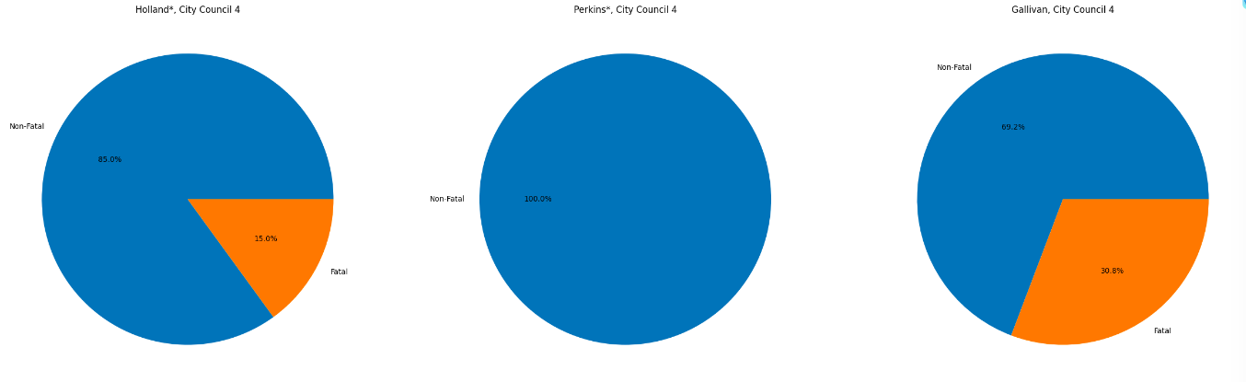
Fatal vs Non-fatal Shootings for D4 Community Centers
Key Findings
For the top 3 community centers in D4 Non fatal incidents happen on average 85% and fatal incidents happen 15%
On average most shootings have more non-fatal vs fatal but its still interesting to note the same trend happening on a local level

Slide 29
Summary
Gun violence is a complex issue with multiple drivers, including demographic, socioeconomic, geographic, criminal justice, and gun law factors.
Analysis suggests that prevention efforts should address the root causes of gun violence, such as poverty and lack of education and employment opportunities, rather than relying solely on criminal justice interventions. Additionally, enforcing strong gun laws and reducing access to firearms can reduce gun violence.

Slide 30
Questions?
Gun Violence

